Slide 1
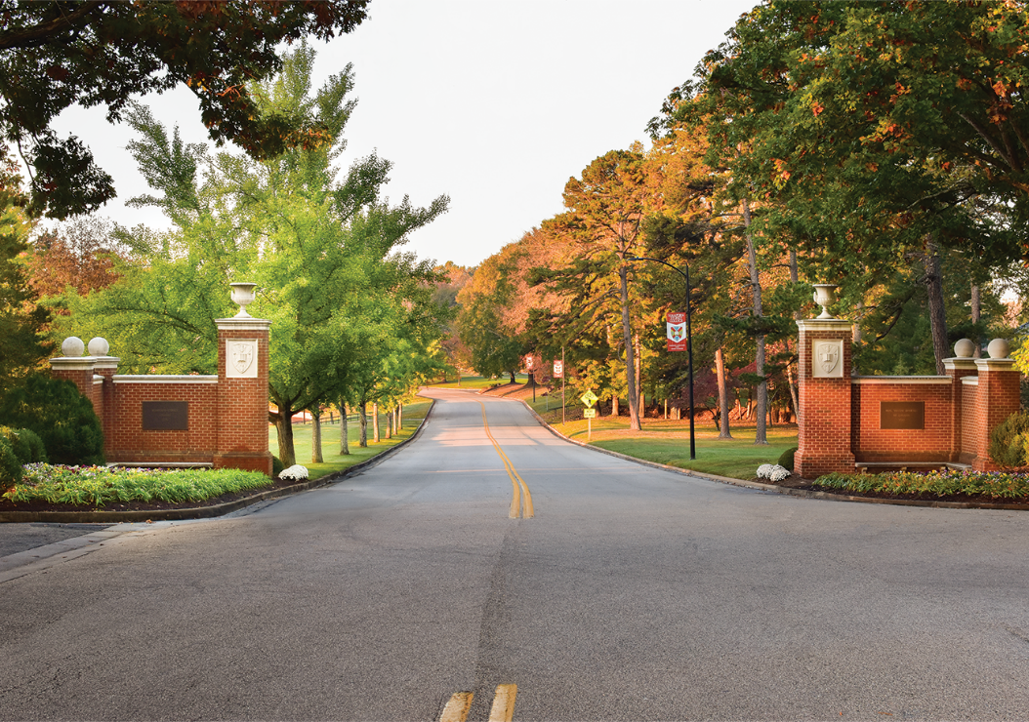
SUMMER ORIENTATION

Slide 2
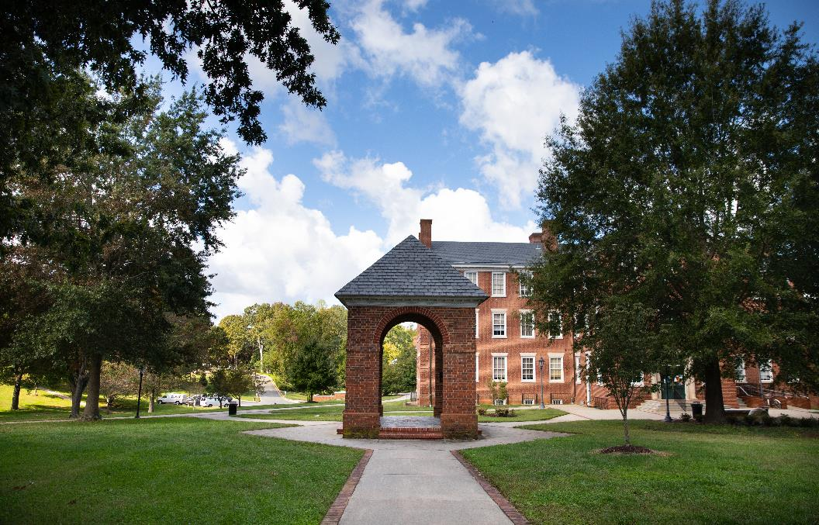
Office of Student Affairs

Slide 3
Dean of Students
Dr. Richard Pantele ’13
Dean of Students
Brown Student Center, 3rd Floor
(434) 223-6043
RPantele@hsc.edu

Slide 4
Executive Assistant to the DOS and OSA
Desiree Lee
Executive Assistant to the Dean of Students and Office of Student Affairs
Brown Student Center, 3rd Floor
(434) 223-6128
Dlee@hsc.edu

Slide 5
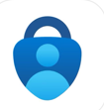
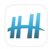
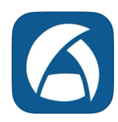
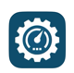

Please install these APPS
Micosoft Authenticator
Atrium Campus
Microsoft Outlook
Helper Helper
Asset Essentials

Slide 6
Conduct, Character, and Greek Life
Dean Dwayne Bowyer ’92
Associate Dean of Students for Student Conduct and Character & Director of Greek Life
Brown Student Center, 3rd Floor
(434) 223-6127
DBowyer@hsc.edu

Slide 7
Health/Counseling/Public Safety

Slide 8
Student Development and Well-Being
Dean Renae Mancastroppa
Associate Dean of Students for Student Development and Well-Being
Brown Student Center, 3rd Floor
(434) 223-6318
RMancastroppa@hsc.edu

Slide 9
3rd Millennium Classrooms
COMPLETE BY AUGUST 1
Online Courses
-Alcohol Wise
-Hazing and Hosting
-Consent & Respect
Access from Enrollment Checklist, H-SC Email, Web: 3rd Millennium Classrooms Student Login

Slide 10
Police and Public Safety
Chief Mark Fowler
Director of Public Safety and Chief of Police
Bush House
(434) 223-6164
MFowler@hsc.edu

Slide 11
Counseling Center
Dr. Clarence Merckerson, Director of Counseling Services
(434) 223-6320
CMerckerson@hsc.edu
Jonathan Shular, College Counselor
(434) 223-6673
JShular@hsc.edu
Adrienne Traylor, Administrative Assistant
(434) 223-6411
ATraylor@hsc.edu
All Offices are located in the Counseling Center

Slide 12
Student Health Center
Nurse Kim Ball
Director of the Student Health Center
Joyner Building, Student Health Center
(434) 223-6167
KBall@hsc.edu

Slide 13
Student Health Center
Required forms for New Students. Due August 1
New Student Physical Form
Immunization Records
Student Health History (completed in portal)
Insurance Plan Information (completed in portal)
Emergency Treatment Consent Form
Immunization waiver forms if needed for Hep B and Meningitis

Slide 14
Student Health Center
MANDATORY REQUIREMENTS
3rd Millennium Courses
Medical Health Information
Failure to fully complete all mandatory requirements by incoming students for the academic year 2025/2026 will result in a registration hold on all delinquent student accounts. A registration hold can prevent students from registering for their next semester classes in a timely manner and impact their ability to get their desired schedule.

Slide 15
High Adventure
Scott Schmolesky
Director of High Adventure
Brown Student Center, 3rd Floor
(434) 223-6717
SSchmolesky@hsc.edu

Slide 16
Housing and Residential Life
Dean Jesse Schrader
Associate Dean of Students for Campus & Residential Life
Brown Student Center, 3rd Floor
(434) 223-6667
JSchrader@hsc.edu

Slide 17
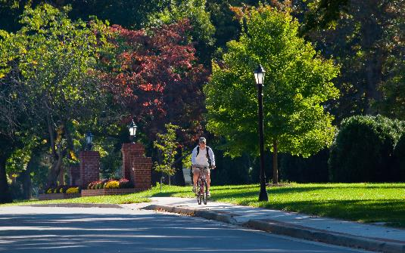
Break
Please be back in 10 minutes

Slide 18
Academic Programs

Slide 19
Academic Program
Dr. Tim Diette
Provost and Dean of the Faculty, and Professor of Economics
Atkinson Hall, 1st Floor
(434) 223-6112
TDiette@hsc.edu

Slide 20
Academic Program
Dr. Ivo Gyurovski
Assistant Dean of the Faculty
Atkinson, 3rd Floor
(434) 223-6429
IGyurovski@hsc.edu

Slide 21
Student Academic Support
Lisa Burns
Director of Academic Success
Bortz Library, 2nd Floor
(434) 223-6286
LBurns@hsc.edu

Slide 22
Community Development

Slide 23
Culture and Community
Dean Desiree Nicholson
Dean of Culture and Community
Bortz Library, 4th Floor
(434) 223-6719
DWashington@hsc.edu

Slide 24
Culture and Community
Dr. Melissa Wood
Director of Title IX, Access, and Student Advocacy Title IX Coordinator
Student Health Center
(434) 223-6061
Mwood@hsc.edu

Slide 25
Civic Engagement
Sandy Cooke
Director of Student Affairs Operations, Orientation, and Civic Engagement
Brown Student Center, 3rd Floor
(434) 223-6340
SCooke@hsc.edu

Slide 26
Students Walk to the
Brown Student Center
Parents remain in this room.
You will meet back up with your son at lunch at the dining hall, Pannill Commons

Slide 27
Parent Session

Slide 28
Parent Session
Dr. Richard Pantele ’13
Dean of Students
Brown Student Center, 3rd Floor
(434) 223-6043
RPantele@hsc.edu

Slide 29

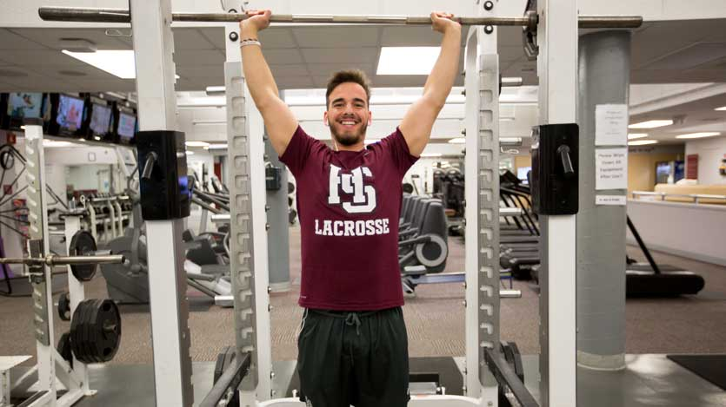
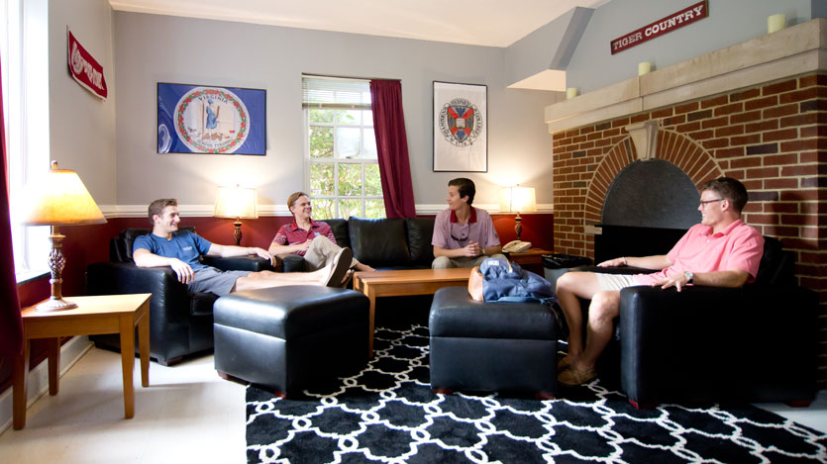
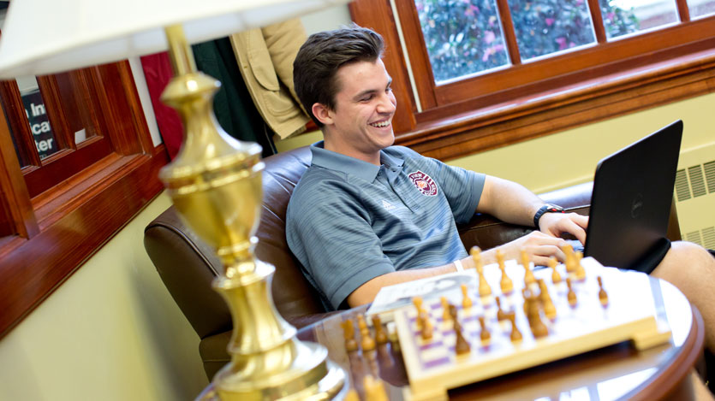
High School vs. College Life

Slide 30
Freshman Year: Know Thyself
“γνῶθι σεαυτόν”
Learning what you enjoy doing – what are your interests?
Identifying what you do well- what are your skills?
Considering what’s important to you? What do you value?
What makes you most like yourself – your true personality!
Who am I now and who do I want to be?

Slide 31
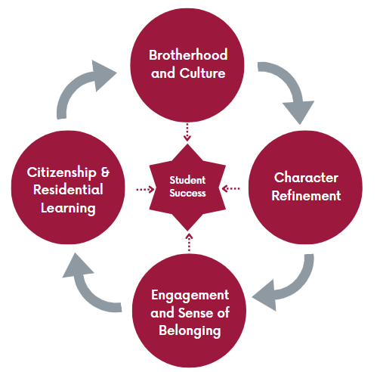

Slide 32
Expectations for Students
Honor Code
Code of Conduct
“The Hampden-Sydney Man will not lie, cheat, or steal, nor tolerate those who do.”
“The Hampden-Sydney Man will behave as a gentleman at all times and in all places.”

Slide 33
Freshman Year: Encourage Your Sons
Try classes you like and find interesting.
Talk with students and professors in different majors to discuss career choices and find out what it’s really like.
Get involved early in school activities – this builds interpersonal skills, teamwork skills and provides experience.

Slide 34
Freshman Year: Encourage Your Sons
Take a few career interest/personality type indicator tests at our Career Development Office
Myers-Briggs
Develop short and long term goals.
Ask other people in your life (family and friends to help you identify your dominate career-related traits.

Slide 35
Freshman Year: Encourage Your Sons
Begin identifying and using all the resources on campus in developing your career-related skills.
Student Affairs office
Student Success Center
Residence Life
Tutors in difficult subjects
Professors in various classes
TAKE ADVANTAGE OF ALL THE FREE STUFF!

Slide 36
Most importantly - Talk to Your Sons
How are you doing?
Do you like your classes?
What kinds of activities are available?
Are you enjoying Residential living?
How are you getting along with your roommate?
Are you feeling overwhelmed? What can we do to help?
How do you expect to handle the social life at H-SC?
What are our shared expectations in regards to academics and how do you feel you will balance social life with academic life?
How does academic performance affect financial aid?

Slide 37
Final Announcements
11:30 – 12:15 p.m. Lunch
12:15 – 1 p.m. Residence Hall Tours will leave from lunch location
1 – 4 p.m. Student Only Advising Sessions
1 – 4 p.m. Parent Information Tables of 2nd Floor of Bortz
Computing Center, Career Center, Housing, Student ID, Vehicle Decal, Student Health, Counseling, Office of Culture and Community, Global Ed and Study Abroad, Flemming Center for Entrepreneurship, and High Adventure Program

